Slide 1
We are international, entrepreneurial and growing fast. Grow your career with us! Deloitte is one of the world's leading professional services firms in the areas of Audit and Risk Advisory, Tax, Consulting and Financial Advisory. In Switzerland, we have more than 1,400 professionals operating out of 6 cities: Basel, Berne, Geneva, Lausanne, Lugano and Zurich (headquarters). Our Consulting team is looking for you! Deloitte Consulting is one of the fastest growing business consultancy firms in Switzerland and within our Consulting practice sits Deloitte Digital – our team of digital ‘sales & marketing’ consultants, technology innovators and creative specialists. In Deloitte Digital, we work with the latest technologies in sales (including Salesforce.com) and marketing (including Adobe) as well as the latest digital platforms (including Apple iOS and Internet of Things technologies), and our team is based in our Deloitte Digital studios around Europe. Sound exciting? It is. See www.deloittedigital.com/eu for more. As a Business Analyst within Deloitte Digital, you will be providing our clients with advice on digital change, helping them to exploit cloud solutions, web, mobile and social media to strengthen their brand and grow their business. You will be working with both our clients and the Deloitte Digital teams to define and optimise digital strategies and support them through digital and multichannel transformation programmes. We take your further development seriously. Deloitte offers a comprehensive internal and external training programme. You need to meet a few basic requirements if you want to make a good start with us: • Master degree completed with good results from a reputable university or equivalent • Excellent knowledge and passion for digital across cloud, mobile, social and e- commerce • Strong organisational skills, with the ability to work independently as well as in a highly collaborative, team-based environment • Strategic thinker and problem solver • Excellent presentation skills and communication abilities at all levels (both internally and client-facing) • Willingness to travel, 3-4 days per week • Excellent command of English and German and/or French What you can expect from us We provide a team oriented environment that allows for both personal and professional growth. You can expect to be fully integrated with support from experienced project managers. Competitive compensation and social benefits are granted. Furthermore, we offer a wide variety of voluntary activities in the areas of corporate social responsibility, culture and sports, e.g. Deloitte Company Triathlon, Steps Counting Challenge, Deloitte Green Journey, and Deloitte Community Investment. Any questions? Get in touch. We look forward to hearing from you! Please submit a complete application, including CV, cover letter, references and degree certificates, using our online career portal www.deloitte.com/careers. We do not accept applications from recruitment agencies for this position. If you have any questions, please contact Stacie Green at talent@deloitte.ch
Job Description
Characteristics
Knowledge
Skill
3 feature vector will be created
Characteristics they are looing for
Knowledge required
Skills desired
Each feature vector can be arbitrary long

Slide 2
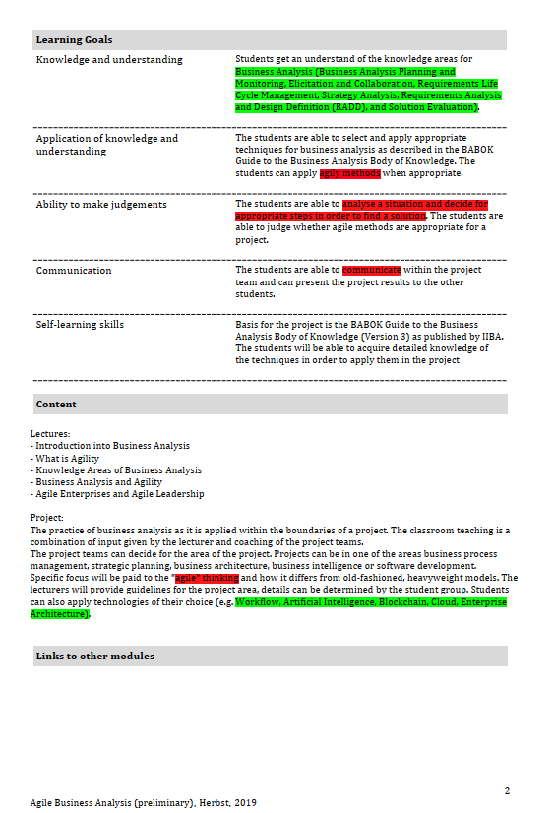
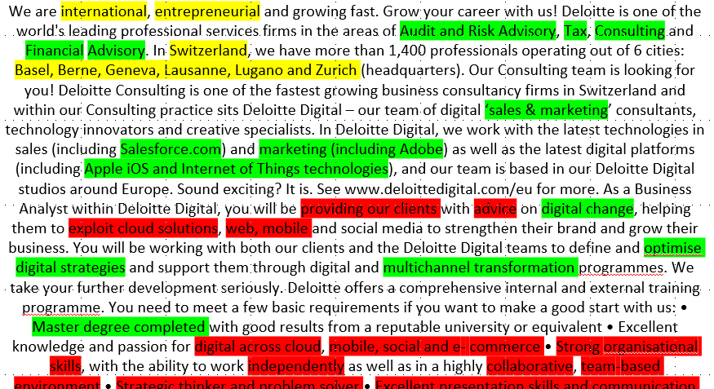
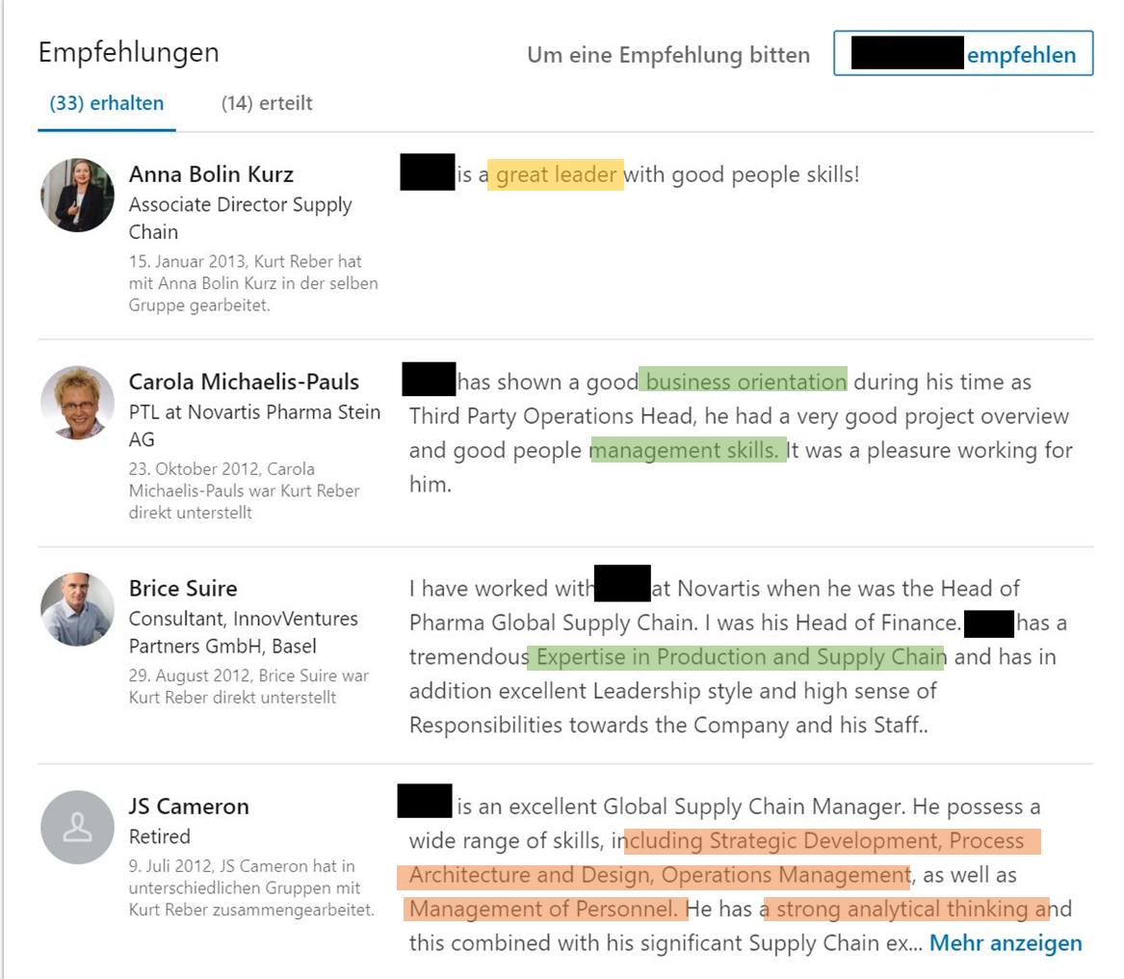
Modules
Characteristics
Knowledge
Skill
3 feature vector will be created
Characteristics they are looing for
Knowledge required
Skills desired
Each feature vector can be arbitrary long
Certification of work
Other skill databases

Slide 3
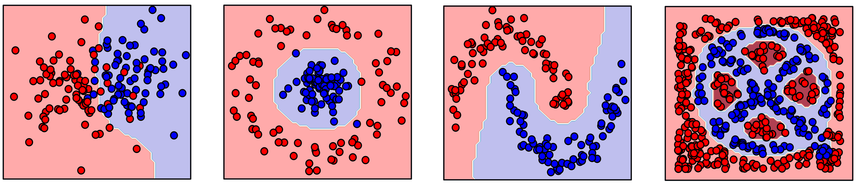
Feature mapping and matching

